Slide 1

INTEGRID
EDP Distribuição and ELLEVIO
Notes:
Sub-Capa

Slide 2
Outline
Quick overview of the used dataset template for the INESCTEC algorithm;
Example of a dataset input;
Example of outputs provided by the INESCTEC algorithm;

Slide 3
Required Data fields for the MV/LV power transformers (PT) INESCTEC algorithm
Manufacturing year
Manufacturing Year of a given MV/LV PT
Data-freeze year
Year of decommission for a given MV/LV PT, which can be due to failure or a management decision
District
Local of installation for a given MV/LV PT at the district level

Slide 4
Required Data fields for the MV/LV power transformers (PT) INESCTEC algorithm
Manufacturer
Manufacturing brand for a given MV/LV PT
(i.e. SIEMENS, EFACEC, etc.)
Installation type
Installation type used when the PT was operationalized
(i.e. PT installed inside a booth or PT installed without a booth)
Failure mode
Failure mode occurred for a given MV/LV PT

Slide 5
Required Data fields for the MV/LV power transformers (PT) INESCTEC algorithm
Age
Measures the time, in years, between the MV/LV PT year of installation and the decommission year
Technology
Differentiates HM/LV PT built with reliable components from ones using economic components, which in turn are less reliable
Failure
Indicates which MV/LV PT have failed with a binary classification (i.e. value ”1” for failure and value “0” for no failure)

Slide 6
Example with 5 data points
Transformer | Data-freeze year | District | Manufacturer | Installation type | Failure mode | Age | Technology | Failure
1 | 2019 | District 1 | EFACEC | WITHOUT BOOTH | NONE | 7 | ECONOMICAL | NO FAILURE
2 | 2019 | District 2 | SIEMENS | WITH BOOTH | NONE | 25 | ROBUST | NO FAILURE
3 | 2010 | District 3 | EFACEC | WITH BOOTH | ENVIRONMENTAL | 30 | ROBUST | FAILURE
4 | 2005 | District 4 | SIEMENS | WITHOUT BOOTH | NONE | 35 | ROBUST | NO FAILURE
5 | 2017 | District 5 | SIEMENS | WITHOUT BOOTH | OPERATIONAL | 7 | ECONOMICAL | FAILURE
The set of features used in the INESCTEC algorithm help explain why the PT has failed.

Slide 7
Example of the results output
Transformer | Age | Failure probability | Failure Year (Optimistic) | Failure Year | Failure Year (Pessimistic)
1 | 7 | 8% | 2037 | 2040 | 2043
2 | 25 | 26% | 2038 | 2040 | 2042
3 | 30 | 37% | 2028 | 2030 | 2032
4 | 35 | 35% | 2020 | 2021 | 2022
5 | 7 | 7% | 2045 | 2049 | 2053
Data is used in the INESCTEC algorithm to mainly predict each PT failure probability

Slide 8
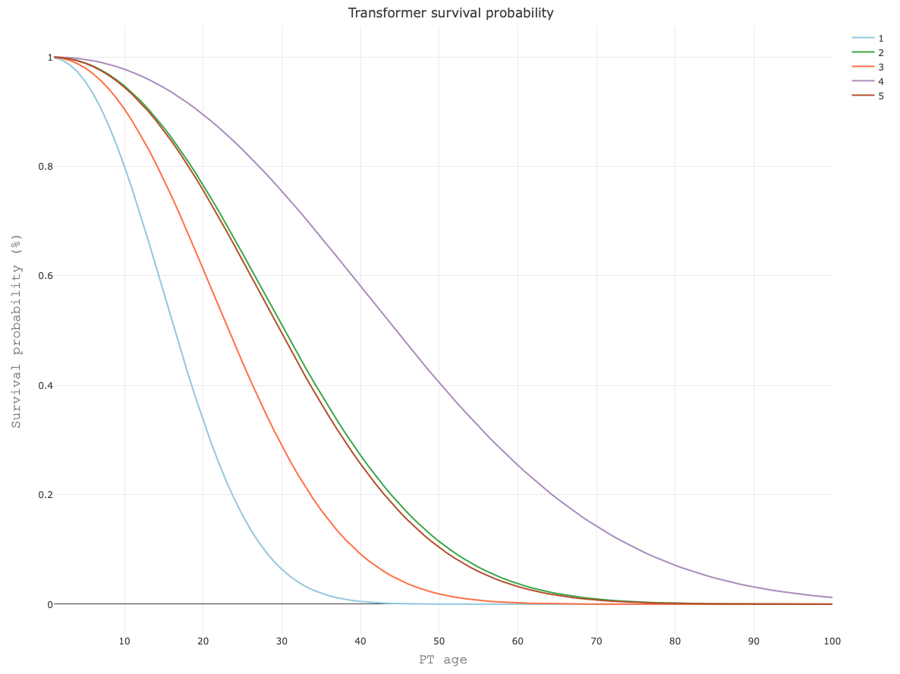
Example of the results graphical output

Slide 9
Example of an aggregated failure prediction for different scenarios
Number of total failures for each year
Year | Failures | Optimistic prediction (95%) | Pessimistic prediction (95%)
2019 | 244 | 212 | 275
2020 | 494 | 450 | 539
2021 | 756 | 702 | 810
2022 | 1022 | 960 | 1084
2023 | 1302 | 1230 | 1373
2024 | 1584 | 1507 | 1662
2025 | 1879 | 1795 | 1963
2026 | 2174 | 2082 | 2266
2027 | 2482 | 2383 | 2580
2028 | 2795 | 2694 | 2897

Slide 10
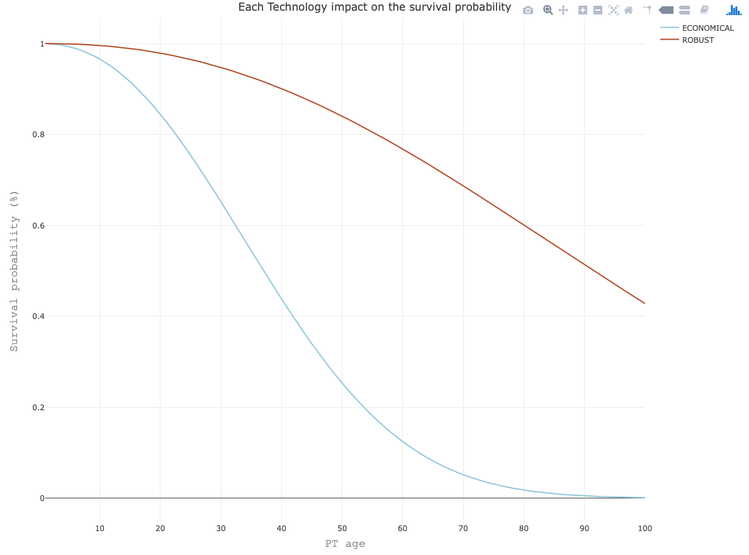
Example of a graphical output - Technology variable impact

